Slide 1
PEN 12
„Scientific Research Methods“
Lecture I – Research Process
Lecture II – Finding and managing literature
Lecture III – Reviews
Lecture IV – Original Paper
Lecture V – Poster Presentations and Pitches
Lecture VI – Literature Clubs and Practical Aspects of Conducting Review
Lecture VII – Workshop: Preparing Your Systematic Review
Task after each lecture
Final exam => Review (5 pages) and Poster
Notes:
Weitere Punkte aus Studienkommission zur Ergänzung?

Slide 2

Deadlines
Manuscript
Submission Deadline: 10.01.2026 (23:59)
Feedback until 18.01.25 – Accepted, Minor Revision, Major Revision
Final Submission Deadline: 31.01.2026
Poster
Submission Deadline: 15.02.2026
Use the possibility to get Feedback!
Theo Taxis
Professorship for Rehabilitative Medicine
PEN-12: Rehabilitation

Slide 3
Grading, Templates
Grading Factors:
Language
Form (citation, abbreviations, reference list) & Structure (PRISMA, Tables & Figures)
Methodology, Synthesis & Interpretation
Independence
Poster Presentation
Templates for the manuscript and the poster
Provided in moodle
Mandatory to use!
Design search term/research question to get a max. of 200-300 hits
Theo Taxis
Professorship for Rehabilitative Medicine
PEN-12: Rehabilitation

Slide 4
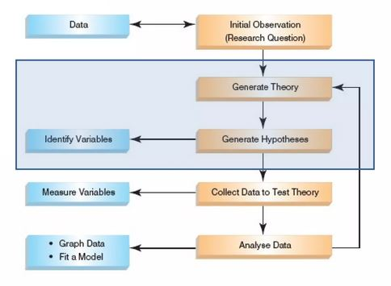
PEN 12
Lecture I – Research Process
Notes:
Weitere Punkte aus Studienkommission zur Ergänzung?

Slide 5
Initial Observation
Finding something that is unclear and needs to be explained
  E.g.: some clinical problem that has several solutions, some being perhaps better than other
Observation is linked to data
  Either already collected data or data that we should collect, to check if we are right about this observation

Slide 6
Generating Theories and Hypotheses
Theories are explanations of some findings
  E.g.: medial temporal lobe (MTL) is important for memory and spatial orientation
  or: epileptic seizures in MTL worsen those functions
Hypotheses and predictions from theories
  E.g.: Temporal lobe epilepsy (TLE) patients who underwent minimally invasive laser ablation in MTL will perform better on those funcitons compared to patients who underwent temporal lobectomy and non-operated patients
Identifying variables
  E.g.: Type of surgery, results on relevant tests

Slide 7
Collecting Data and Testing Hypotheses
Hypothesis
  E.g.: Laser ablation leads to better performance of vestibulo-MTL (rotational memory, spatial orientation, balancing) functions
Independent variable
  Causal/manipulated variable – here it is the surgery
Dependent variable
  Effect/measured variable – here it is performance on tests (RM, TCT, CBT)
Confounding variable
  Affects the outcome but has not been systematically manipulated – e.g. the relationship between surgery and improvements of functions is confounded by medication (can be ruled out: removing causal variable should remove the effect)

Slide 8
Types of Hypotheses
Null hypothesis
  No effect
  We generally don‘t want that outcome
  E.g.: Surgery does not lead to improvement
Alternative hypothesis
  Expected effect took place
  We want such outcome
  E.g.: Surgery leads to improvement

Slide 9
Types of Variables
Categorical (divided into two or more categories)
  Binary for two (e.g. surgery or no surgery)
  Nominal for more than two (e.g. young, middle-aged and old)
  Categorical for more than two in some order (e.g. score on rehabilitation assessment scale of 1-5)
Continuous
  E.g. scale – body weight, height…

Slide 10
Types of Research
Correlational/Cross-sectional (divided into two or more categories)
  Relationship between or more variables, usually assessment of differrent groups of at one time-point
Experimental/Longitudinal
  Manipulating one or more variables to see the effect, cause/effect can be interpreted, usually assessment of one or more groups of at two or more time-points

Slide 11
Methods of Data Collection
Within group/subject (Repeated measures)
  E.g.: Same subjects at different time-points
Between group/subjects
  Different subjects in experimental conditions (independent groups)

Slide 12
Types of Variation
Systematic
  Differences in performance caused by experimental manipulation
Unsystematic
  Differences in performance caused by unknown factors (e.g. time of day, measurement error…)
Randomization
  Reduces unsystematic variation

Slide 13
Analysing Data
Stats

